Slide 1



Aesops Consulting
Speaker: William, John

Slide 2
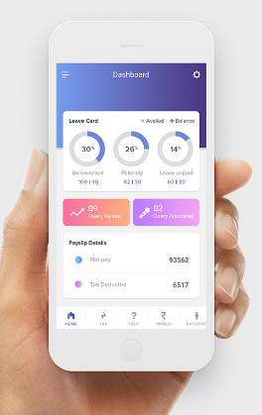
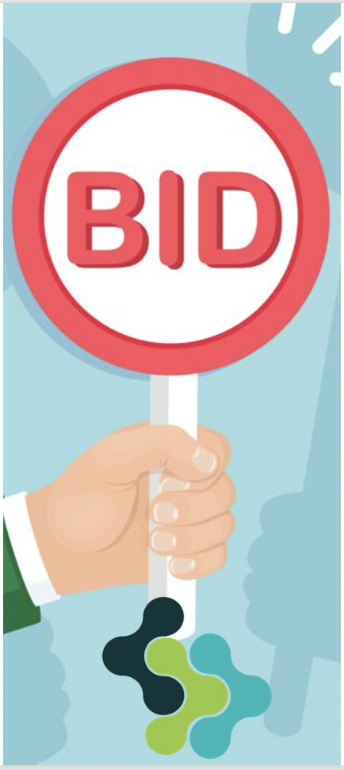
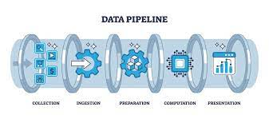

A three pronged approach
App
Bidding
pipelines
Build an app that monitors messages
The app mines the data and updates an online dashboard with summary stats
The app has a button to collect pictures of receipts
Consultancy through bidding projects
We need to identify and monitor advertised consultancy gigs
Build a portfolio of satisfied clients
Target small businesses
We use free tools to build for them data pipelines
Small fee (e.g. 3k and 200 monthly maintenance)

Slide 3
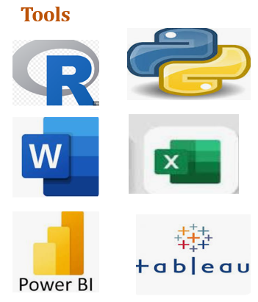
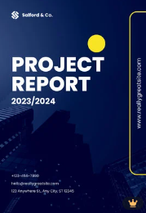
Approach 2:
Harnessing the expertise, experience and qualification of our members.
We proudly have expertise in data analysis/analytics, machine learning, statistical modelling, programming language proficiency, and domain knowledge.
Bidding
Consultancy through bidding projects
We need to identify, and monitor advertised consultancy gigs
Build a portfolio of satisfied clients
Project bidding:
We shall be bidding projects, understand the client, work on all the data analytics required.
Generate the analytics from the data and report.

Slide 4
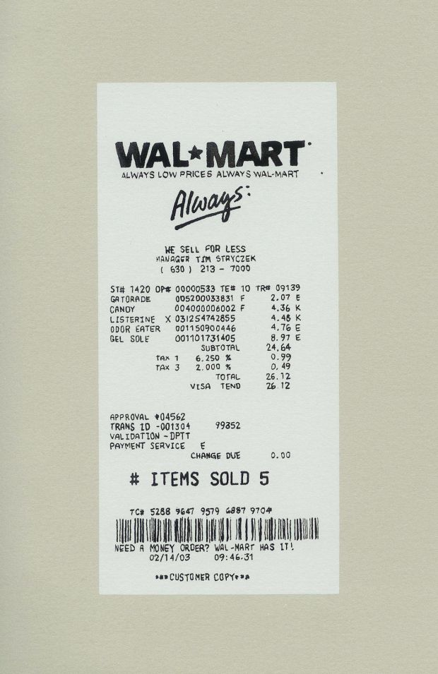
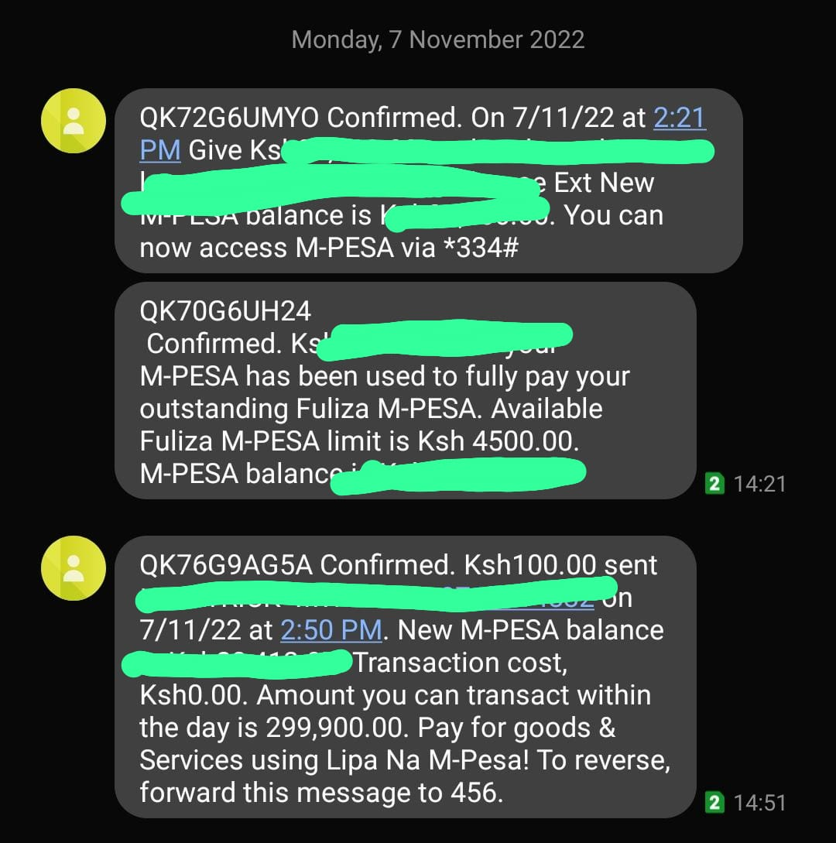

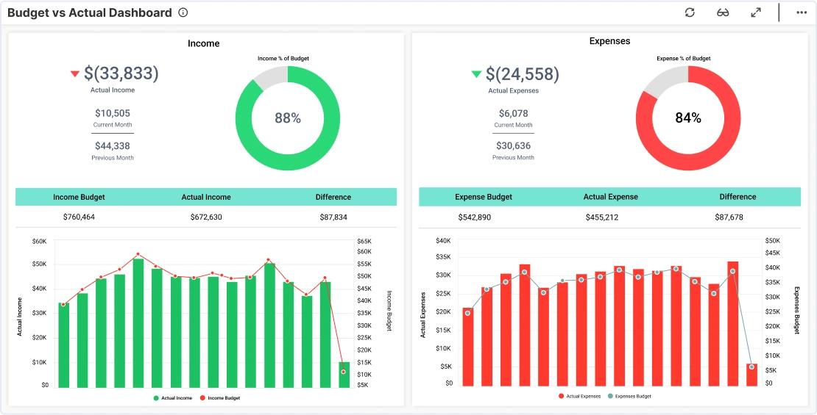
Approach 1:
App
Build an app that monitors messages
The app mines the data and updates an online dashboard with summary stats
The app has a button to collect pictures of receipts

Slide 5
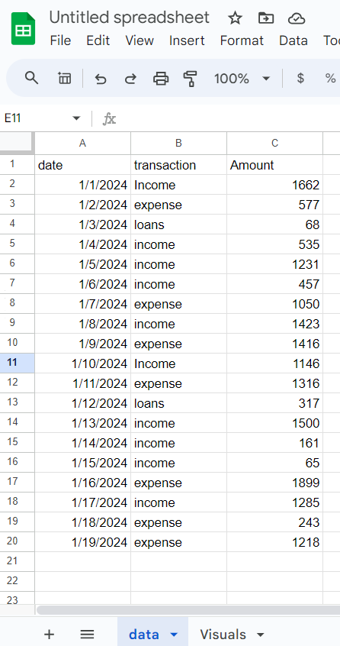
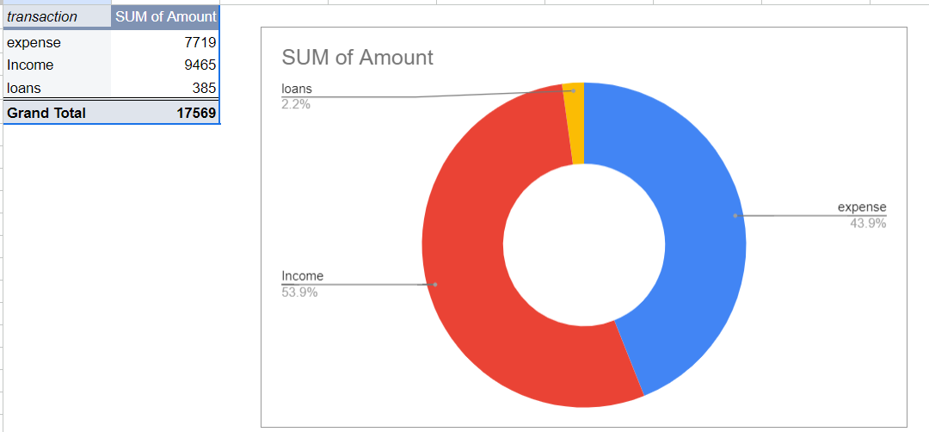
Approach 3:
pipelines
Target small businesses
We use free tools to build for them data pipelines
Small fee (e.g. 3k and 200 monthly maintenance)

Slide 6
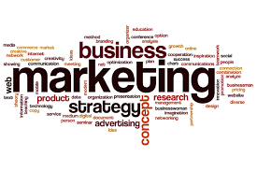
Considerations:
App
Bidding
pipelines
Marketing strategy- Ads, sales team
Monetization, ads ,paid features eg after 3 months
Timeline 6 months
Marketing strategy- Identify Ad and bid; build a portfolio
Monetization: Charge consultancy fee
Timeline: Immediately
Marketing strategy- Ads, sales team
Monetization:
Setup fee eg 3k, consultation fee e.g. 500, maintenance fee e.g. 200
Timeline 1 month

Slide 7
Q & A
Questions?

